Slide 1
Engaging the 21st Century Workforce
DiversityInc
September 30, 2015
Bill Castellano, Ph.D.
Associate Dean
SMLR Executive and Professional Education
castellano@smlr.rutgers.edu

Slide 2
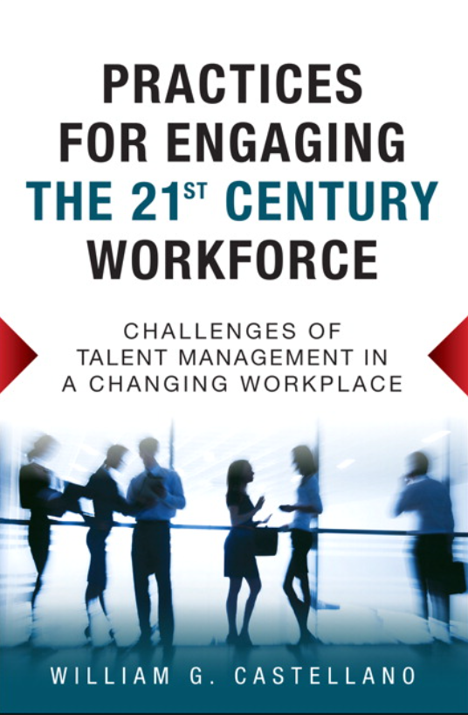

Slide 3

What is the New Normal?
Technological Trends
Globalization Trends
U.S. Labor Force Trends
U.S. Economic Trends
Structural Shifts

Slide 4
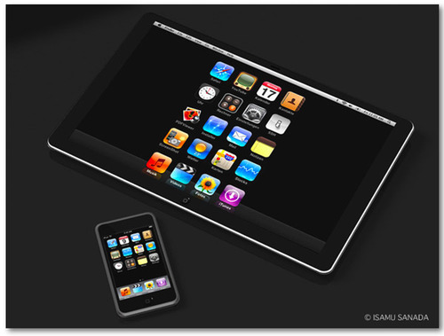
Technological New Normal
Commoditization of Technology – faster and cheaper
Transforming how we work and live
Continuous innovation
Creative destruction
Increasing need for complex skills
Reducing costs of entry
Driver of globalization

Slide 5
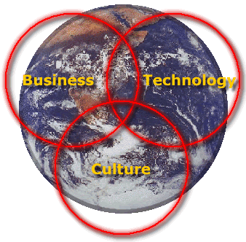
Globalization New Normal
End of U.S. Golden Age
Seismic Population Shifts
More educated workers
New markets
New competition

Slide 6
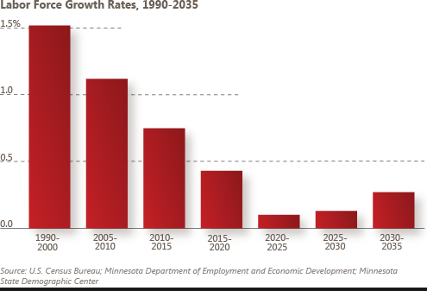
U.S. Labor Force New Normal
Slowing Growth – and Aging
Increasing Diversity
Supply and Demand Imbalances – Skills Gap
Multiple Sources of Talent

Slide 7
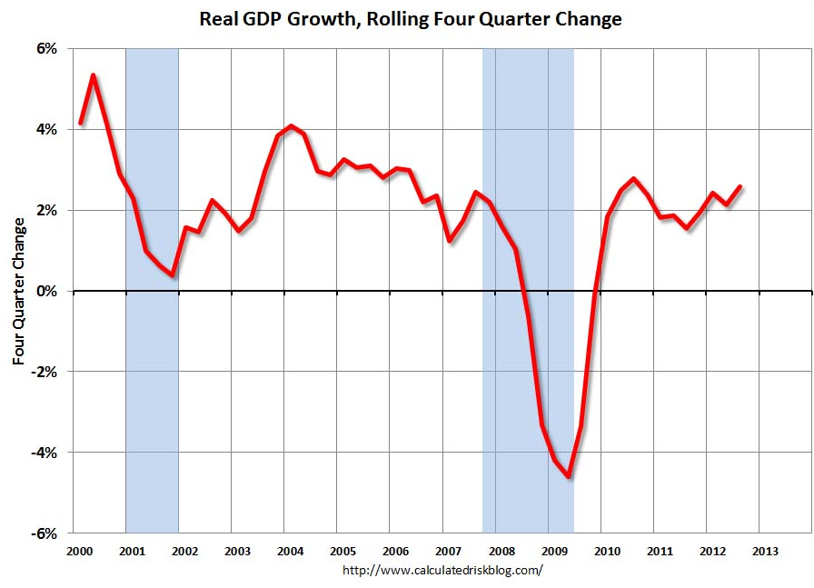
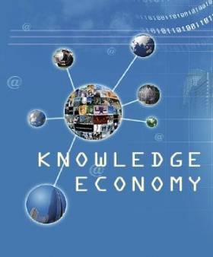
Economic New Normal
Slower Growth
Greater Reliance on Intangible Assets

Slide 8
Talent Management in the New Normal
Challenges Managing the 21st Century Workforce
Managing Uncertainty –Black Swans
Demand for New Competencies
New Organizational Structures
Multi-Generational Workforce
Diverse and Global Workforce
Multiple Sources of Talent
= Need for Organizational Adaptability
= Greater Focus on Employee Engagement
Increased Complexity

Slide 9
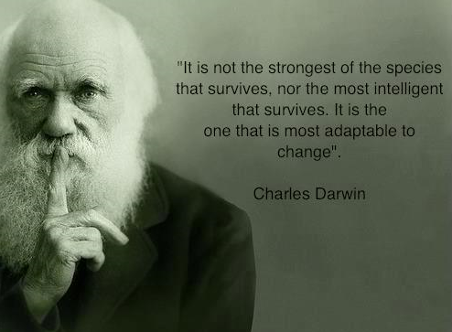
Organizational Adaptability Requirements
Sophisticated Workforce Planning Process
Effective Management of multiple sources of talent
Collaborative relationships with strategic partners
Engaged Workforce – both employees and contract human capital

Slide 10
Employee Engagement Framework
DRIVERS OF ENGAGEMENT
HR SYSTEM
DEVELOPMENT
FLEXIBILITY
AUTONOMY
MEANINGFULNESS
ROLE FIT
LINE OF SIGHT
PERCEPTIONS OF FAIRNESS
COWORKER RELATIONSHIPS
MANAGEMENT
Trustworthiness
Supportive
Recognition
Integrity
LEADERSHIP
Transformational
Vision
Openness
Cultural agility
PSYCHOLOGICAL STATE
ENGAGEMENT
Job Involvement
Affective Commitment
Empowerment
Positive Affectivity
Recruitment, Selection, Training & Development
Job Design
Organizational Structure
Employee
Competencies
Work
Environment
BEHAVIORAL ENGAGEMENT
Extra role/ OCB
Proficient, adaptive, creative
Employee
Attitudes
and Behavior
STRATEGIC OUTCOMES
Productivity
Innovation
Quality
Customer Satisfaction
Incentives and Rewards
Performance Management
FINANCIAL OUTCOMES
Revenue
Profits
Market Value

Slide 11
Mapping Human Capital
D
A
Low UNIQUE high
C
B
Low VALUE High

Slide 12
The Human Resource Architecture
Externalization
Internalization
Mode: Partnership
Collaborative-based
HR System
Mode: Knowledge work
Commitment-based
HR System
Relational
low Uniqueness high
Mode: Contract work
Compliance-based
HR System
Mode: Traditional job
Productivity-based
HR System
Transactional
low Strategic Value high

Slide 13
One Size Does Not Fit All
There is a not a “one-size-fits-all” way of managing and engaging the 21st Century Workforce:
  Multiple Generations
  Multiple Family Arrangements
  Globally Diverse

Slide 14
Managing Traditionalists
Called traditionalists because of their traditional values, believe duty comes before pleasure
Motivated by being recognized for their experience
Seek a high-involvement work place where their opinions are valued
Value opportunities to mentor younger employees
Seek better supplemental health plans

Slide 15
Managing Baby Boomers
Opposed to the command-and-control management styles of earlier generations
Motivated by position, responsibility, perks and prestige
Value professional development – continuing professional education, support to join professional groups, etc.
Key motivator is financial security
Phased Retirement Programs
  Offer part-time work with benefits for a period of time before full retirement.
Mentoring programs
  To share their experience, knowledge and skills with younger works.

Slide 16
Managing Gen X
Include in succession planning programs
Provide training and development focused on developing transferable skills
Offer tuition reimbursement for continuing education that supports career advancement
Value increased empowerment and decision making
Provide freedom to work on projects that interest them
Seek flexible work arrangements to balance work and family life

Slide 17
Managing Gen Y
Expect a fast-track career yet do not buy into the need to “pay dues”
Desire a purpose and seek meaningful and challenging work
Value collaborative rather than competitive work environments
Appreciate feedback and recognition from management
Prefer an informal and less personal (high-tech) communication style
Training and development focused on self improvement
Value flexible work arrangements that support work-life balance and volunteerism
Like a fun work environment with informal dress codes
Seek leisure activities with high-quality work colleagues
Value perks in the workplace (gym, free food, work outings, etc.)

Slide 18
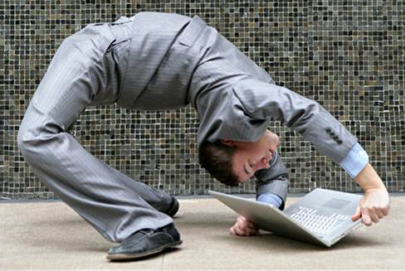
Desire for Flexibility
All three dominant generations – Boomers, Xers, and Yers, value and seek work flexibility.
Dual-income couples, working parents, single parents, students, and transitioning retirees seek work flexibility.
No gender differences, and both young and older workers value and seek flexibility.
More and more senior managers and executives have expressed a desire for more flexibility.

Slide 19
Increasing Corporate Social Responsibility
Reflects the values of an organization
Much more than PR and philanthropy
Need capabilities to:
  augment and monitor corporate decision-making
  promote and protect the image of the firm
  scan and monitor external trends that impact the reputation of the firm
  develop sustainability as a core competency
  enhance transparency

Slide 20

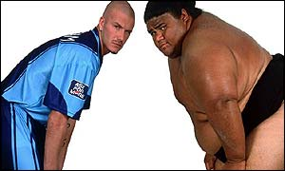
Global Competence
Cultural Knowledge
Intercultural Experiences
Personality
Developing
Cultural Agility
Global Competence
Cultural Knowledge
Intercultural Experiences
Personality

Slide 21
Immersive Global Work Experiences
Opportunities for significant interaction with host national peer-level colleagues
Opportunities to learn the limits of one’s knowledge and question one’s assumptions

