Slide 1
Employee Resource Groups Strategy & Governance
April 2014

Slide 2
Dell’s ERG Footprint
130+ Chapters; 14K+ team members; 15K+ memberships
North America
EMEA
10 ERGs; 38 chapters
EMEA 6 ERGs; 53 chapters
.
LatAm
APJ
5 ERGs; 18 chapters
4 ERGs; 24 chapters

Slide 3
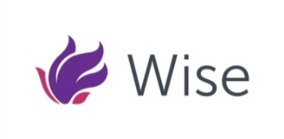
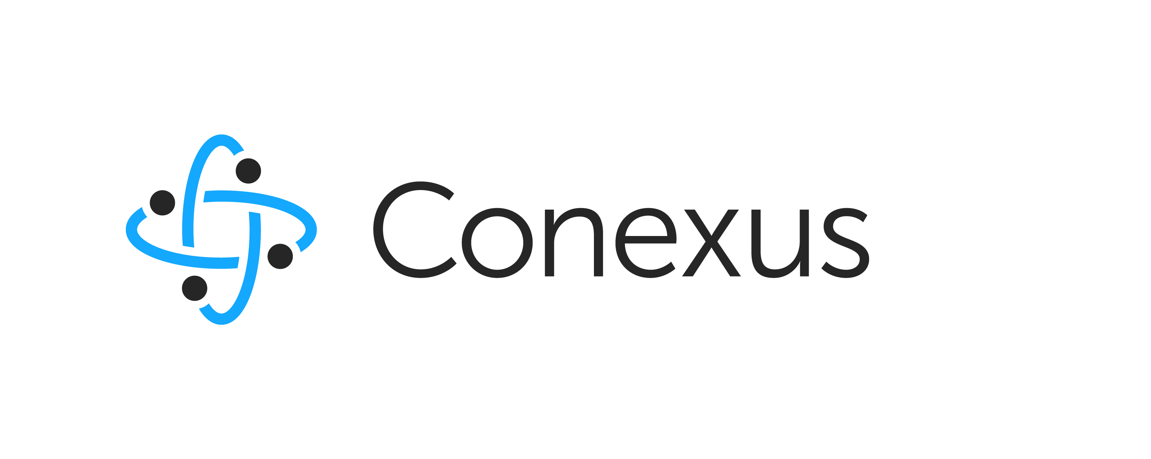
Dell’s ERG Portfolio
Mosaic (EMEA pilot)

Slide 4
What is governance?
“Governance” is primarily about the rules and norms that guide the relevant activity.
“Governance” refers to the actions and processes by which stable practices and organizations arise and persist. These actions and processes may operate in formal and informal organizations of any size and to any number of humans engaged in some purposeful activity.
“Governance" is the concrete activity that reproduces a formal or informal organization

Slide 5
Governance Highlights
Standard Operating Procedures & Metrics
Global ERG Online Community, Comm’s, Budget Mgmt, Event Mgmt, Scorecards
Regional & Global Framework
Councils for oversight & collaboration; Linkage into broader Dell processes
Defined Org Structures
Global/regional/local; Defined Roles; Term Limits
Consistent Strategies
Consistent global goals, Common ERG charter & approval templates
Guiding Principles
Aligned with Dell’s Values, People & Diversity Strategies, Business Strategy
5

Slide 6
FY14 Global Wise Charter
Mission
Provide a platform of networking, ongoing learning and exchange that positively impacts our team members, Wise Chapters, business results, workplace, and communities. We will do this by:
Building a culture that values and is influenced by all diverse perspectives
Guiding an environment where women have significant influence on the company and the industry
Creating avenues to encourage and develop leaders
Vision
Enable women to grow and thrive by creating connections and providing leadership and expertise to deliver on the promise of Dell’s strategy.
Initiatives
Customer & Business Impact
(Bobbi, Aongus, Marcela)
Professional Development & Networking
(Li, Maureen, Betsy)
Community Engagement
(Benedikte, Yvonne & Janet)
Brand Advocacy
(Laura, Marie, Rosandra)
Notes:
Brand - Building the Dell brand as a great place to work for women
Customer impact - Positioning Dell for success with female customers and growing our business’.
Professional Development & Networking - Providing opportunities for team members to develop and network.
Community Engagement - Supporting Women initiatives in the communities we live.

Slide 7
GenNext Charter Mission, Vision, and Values
Mission
Vision
Objectives
GenNext seeks to provide employees with opportunities to develop, connect and engage with one another through:
Business Development - provide an alternative avenue for review of new products and marketing while giving employees the opportunity to learn more about our products and become brand champions
Community Involvement - identify, promote and participate in positive, impactful and fun opportunities for GenNext to make a difference in the local community
Social Networking - develop a Dell-wide network of young professionals and new employees which will facilitate greater communication across functions and create excitement for working at Dell
Professional Development - empowering young professionals and new hires at Dell to develop and advance their careers
Our core vision is to inspire every potential employee to join the Dell team and every current team member to be proud to represent the image, reputation and success of Dell
GenNext is focused on establishing a network for new hires and young professionals which fosters Dell's growth and success through community involvement, personal empowerment and professional development

Slide 8
People. Passion. Progress
In Spanish the word Adelante means onwards or forward. At Dell, the word Adelante means foot-forward whereby our collective input advances Dell – its leadership, its people, and the community it serves
Mission Statement
To enhance the personal and professional development of Hispanics and leverage our creativity and experience in an effort to help Dell establish and maintain a competitive advantage.
Strategic Pillars
People
Community
Business
Globalization
Membership
Mission
Enhance our presence with Hispanic professional organizations and provide high impact solutions focused on accelerating the development of new and existing Hispanic leaders
Mission
Make a meaningful difference in underserved Hispanic communities by using Dell’s technology solutions, resources and know-how
Mission
Be a resource group for the business, driving measurable benefits to internal and external customers
Mission
Define Adelante globalization strategy and membership engagement mechanisms
For more about Adelante visit our page: Adelante’s ERG Page
To Join click here: Join Adelante

Slide 9
Customer & Business Impact Overview
Simplify our Strategy
WISE Think Tanks
Customer Engagement
Educate members on Dell overall and BU strategies
Educate members on how to apply broader business strategy to “how they work”
Create opportunities to share business ideas across BUs and functions to impact business
Collaborate with PG & Merchandising to evaluate consumer products & services
Monitor Social Networks
Respond to ad-hoc business focus group requests
Increase member involvement in internal & external women initiatives (e.g., WPB, WITI)
Drive incremental business opportunities and new customer relationships through networks and by partnering with other companies (e.g., Microsoft)

Slide 10
3x3 Impact ERG:____________ Region/Site:___________
Team Member Engagement
Community Focus
Business Impact
Marketplace & Brand
Marketplace & Brand
Branding events
Supplier diversity focus
Awards
External speaking engagements
External development
events
Volunteer events
Speaking events
Promotion of Dell’s brand in the marketplace as being the employer & supplier of choice with diverse candidates & communities.
Culture & Engagement
Culture & Engagement
Professional development initiatives
Membership / All Hands events
Networking / Social
Internal charity events
Creation of a welcoming workplace where differences are embraced to drive organizational effectiveness.
Representation & Pipeline
Representation & Pipeline
TA Initiatives
Membership growth
Chapter growth
Leadership
Engagement (LIL)
Grow a diverse workforce that drives innovation & thought leadership for customer market expansion & financial performance.

